Slide 1

By : Omar M.Hussein, Sara Ferrari, Zhihong

Slide 2
The “How Might We?”
Challenge: Improve the interactivity and means of communication of the canvas system.
Subject: For education contact between students and professor is crucial. Moreover, also the interaction between students is an effective way to improve. Enhance the connection and the sharing will give us a major attractive tool and increase the market share.
Small HMW: facilitate communication between all the parties involved.
Solution: Improve a Notification feature with desktop alerts & Create a standalone canvas messenger phone application.

Slide 3
Top scratch ideas before interview
Create a Rubric generator/editor (idea1- 30/30)
Export/import All Grading Comments to/from a readable file(idea2 - 30/30)
Text-recommendation in messages.(idea3 - 30/30 )
Historical question forums about assignments and certain topics Updated Yearly(idea4 - 28/30)
improve notifications(idea5 - 28/30)
students can make groups(idea6 - 27.5/30)
connect the files with dropbox(idea7 - 27/30)

Slide 4
What stuck on the wall after the interviews
{Time to group}
You've Got Mail
We have to improve notifications for Canvas. Using the report on email is not the most efficient way to interact on time. We need to create notifications like any other app when something that you like change or is added.
KPI: The number of people who enabled the feature.
We have to improve group function of Canvas.Waiting for teacher to assign is not very efficient to work on the group. We need to create groups freely like any other app(such as Whatsapp) when you want to work or discuss with some people together.
KPI: The number of groups created.
Use Java to improve the app and create notification and settings.
This extension of messages function can rely on either java or JSON

Slide 5
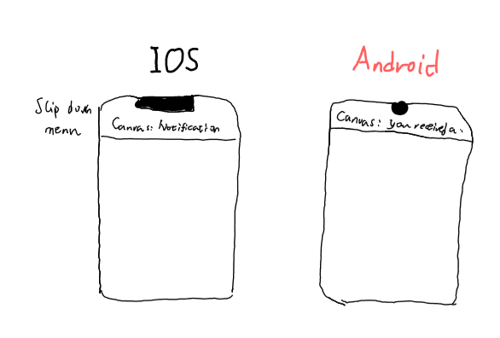
You've Got Mail
We have to improve notifications for Canvas. Using the report on email is not the most efficient way to interact on time. We need to create notifications like any other app when something that you like change or is added.
KPI: The number of people who enabled the feature.
Use Java to improve the app and create notification and settings.

Slide 6
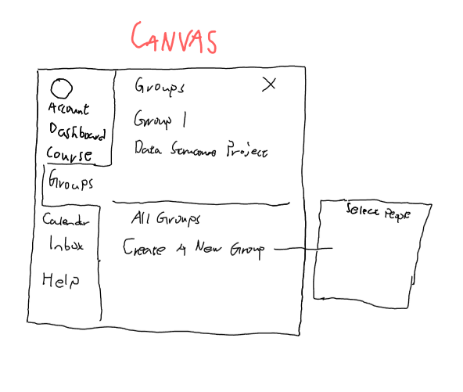
{Time to group}
We have to improve group function of Canvas.Waiting for teacher to assign is not very efficient to work on the group. We need to create groups freely like any other app(such as Whatsapp) when you want to work or discuss with some people together.
KPI: The number of groups created.
This extension of messages function can rely on either java or JSON

Slide 7

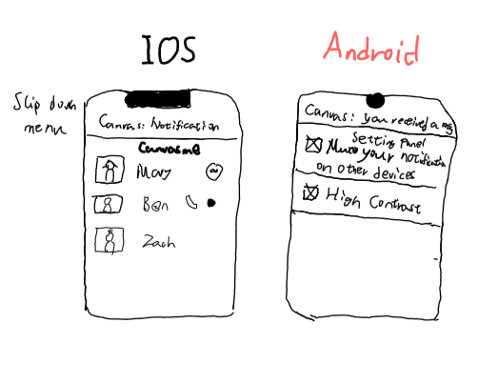
Canvas-ME
There is a need for a separate fully functional phone canvas phone application, that would allow students and professor to communicate a lot better without making the original Canvas application slow down with all the added complexity.
Inspired from the You got mail idea, we decided that the messenger app would have shared notification feature. We want to create a desktop app to always be update.
KPI: The number of people who enabled the feature.
Use Java/Swift to improve the app and create notification and settings. This extension of messages function can rely on either java or JSON
We decided to join the two previous ideas because they will synergize well together and solve most of the problems.

Slide 8
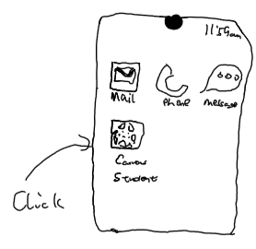
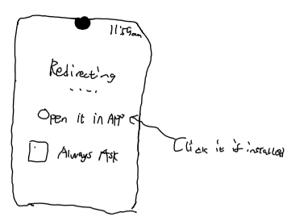
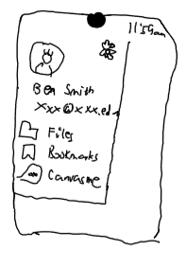
Storyboard Part 1
Sketch | Sketch | Sketch
Open Canvas app | Click Canvas-Me | Being redirected

Slide 9
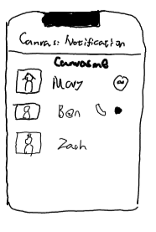
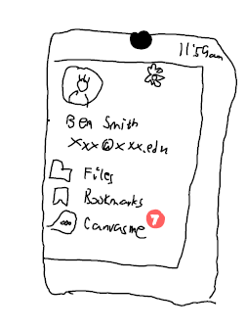
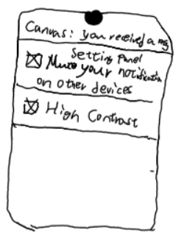
Part 2
Sketch | Sketch | Sketch
Chat or call | Change the notifications settings | Check presence of new messages in Canvas

Slide 10
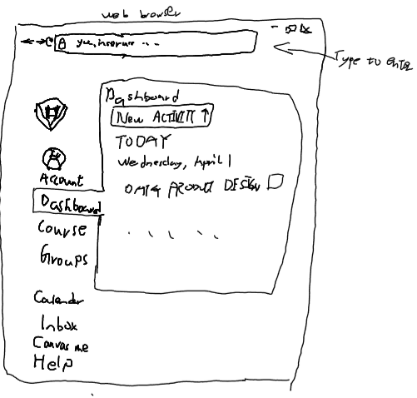
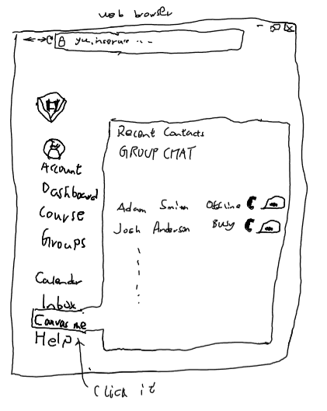
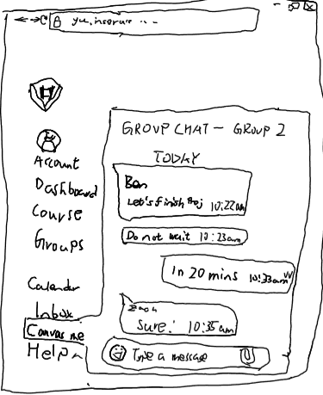
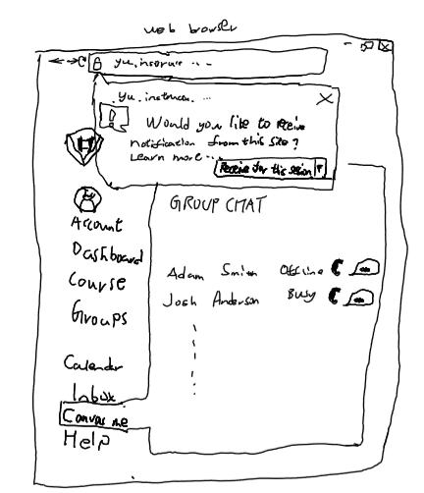
Part 3
Sketch | Sketch | Sketch | Sketch
Go to your browser | Open the chat | Chat in browser | Add desktop notifications

